Slide 1
Introduction to Verilog
Mark
bhbruce.cs07g@nctu.edu.tw

Slide 2
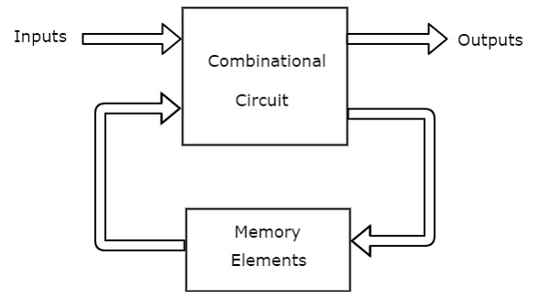
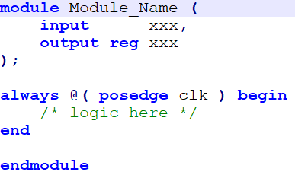

Difference Between Hardware and Software
Control synchronization
Combinational vs sequential
Parallel data access
Parallel behavior

Slide 3
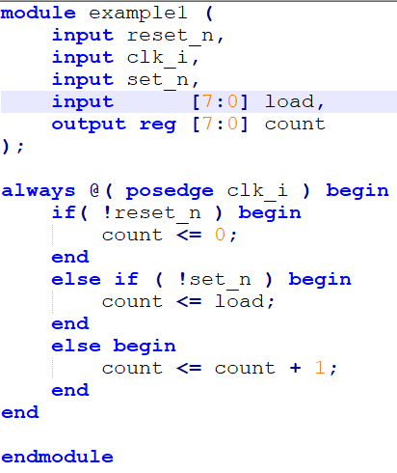
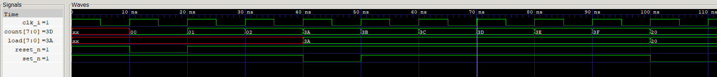
Data type
Wire
“Status of the bus at the moment”
Cannot “store” over clock cycle
Cannot be left value within clock triggered always block
Reg
Buffer along the circuit
In sequential circuit, this is often the pump of the circuit

Slide 4
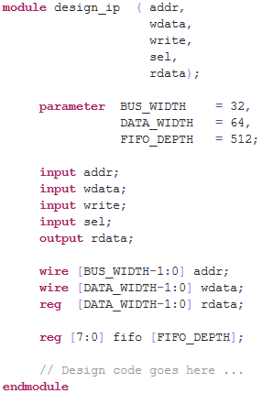
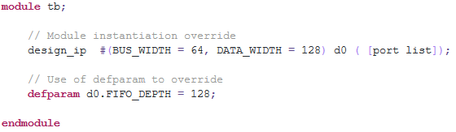
Data type – Cont.
parameter

Slide 5
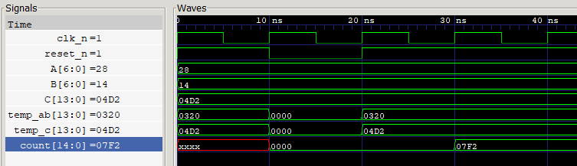
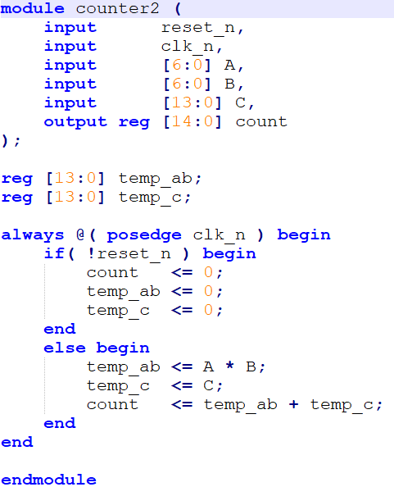
Blocking vs Non-Blocking
A
temp
X
B
output
+
temp_c
C

Slide 6
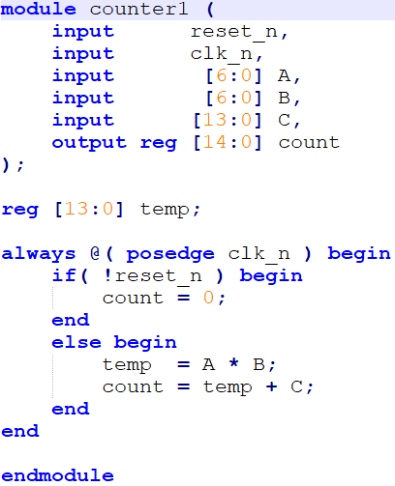
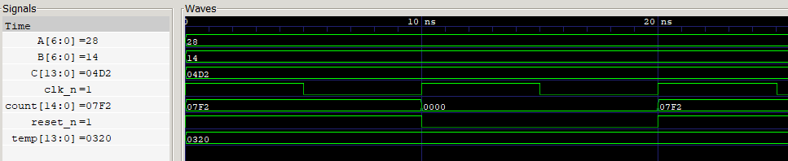
Blocking vs Non-Blocking
A
temp
X
B
output
+
C

Slide 7
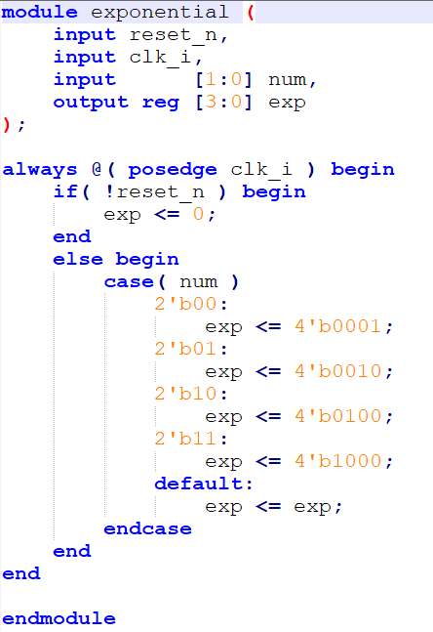
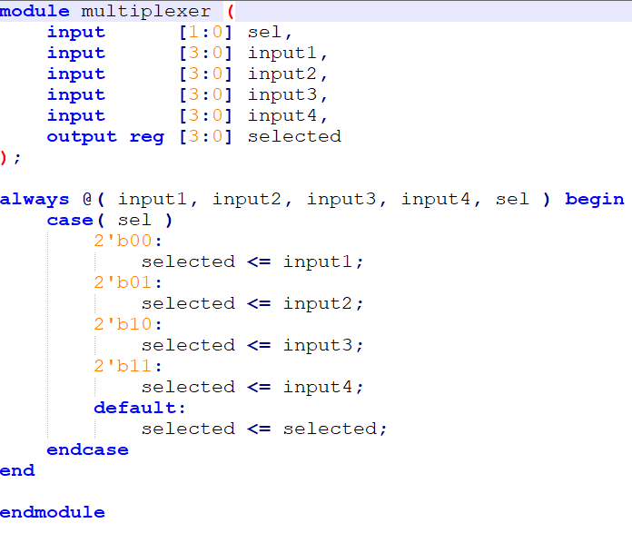
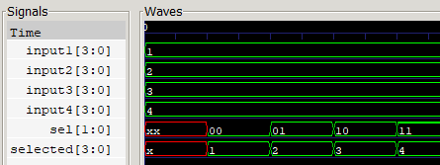
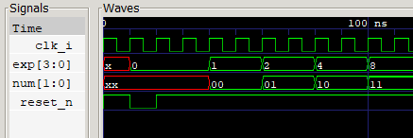
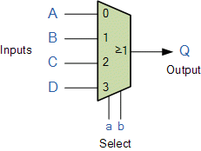
Decoder and Multiplexer

Slide 8
Avoiding latch in Verilog
always @( a, b, c, x, y, z ) begin
x = a;
y = b;
z = c;
End
always @( a, b ) begin
if( a ) begin …..; end
else if ( b ) begin ……; end
else begin ….; end
end
All inputs used must appear in trigger list
Unless all conditions are listed, use default ( case ) or else ( if else statement ) to prevent unpredicted behavior

Slide 9
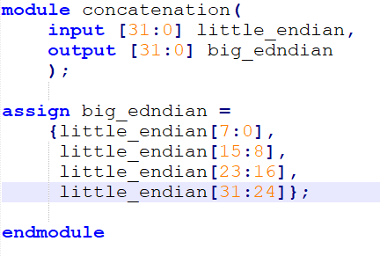

Partial bit operation
little endian
31:24
23:16
15:8
7:0
31:24 | 23:16 | 15:8 | 7:0
big endian

Slide 10
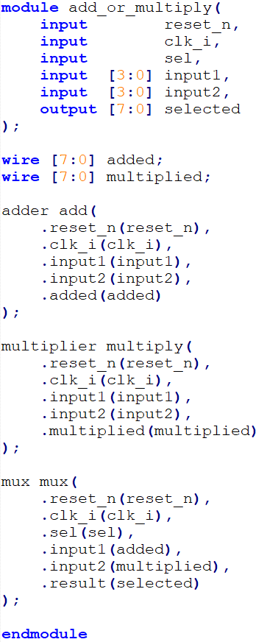
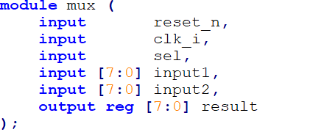
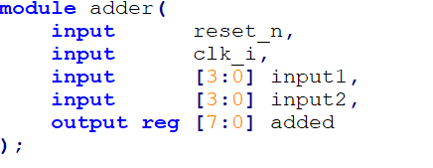
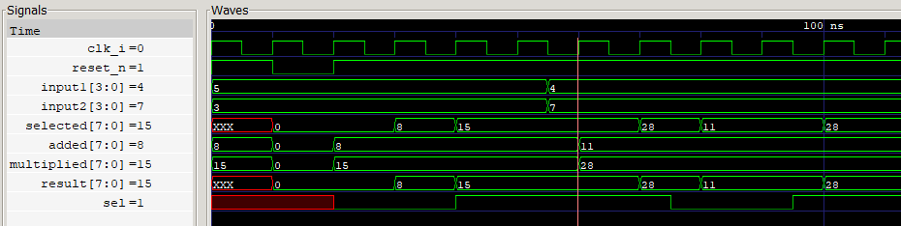
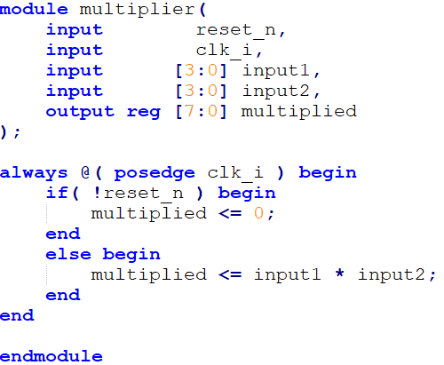
Nested module
multiplier
input1
multiplied
input2
sel
mux
clk_i
selected
Reset_n
adder
added

